Slide 1
Open-source software as a hammer for breaking barriers to adoption
Intelligent Building Operations Workshop
UC Boulder, Colorado
Ján Drgoňa Core developers: Aaron Tuor, James Koch, Madelyn Shapiro, Wenceslao Shaw Cortez, Draguna Vrabie

Slide 2





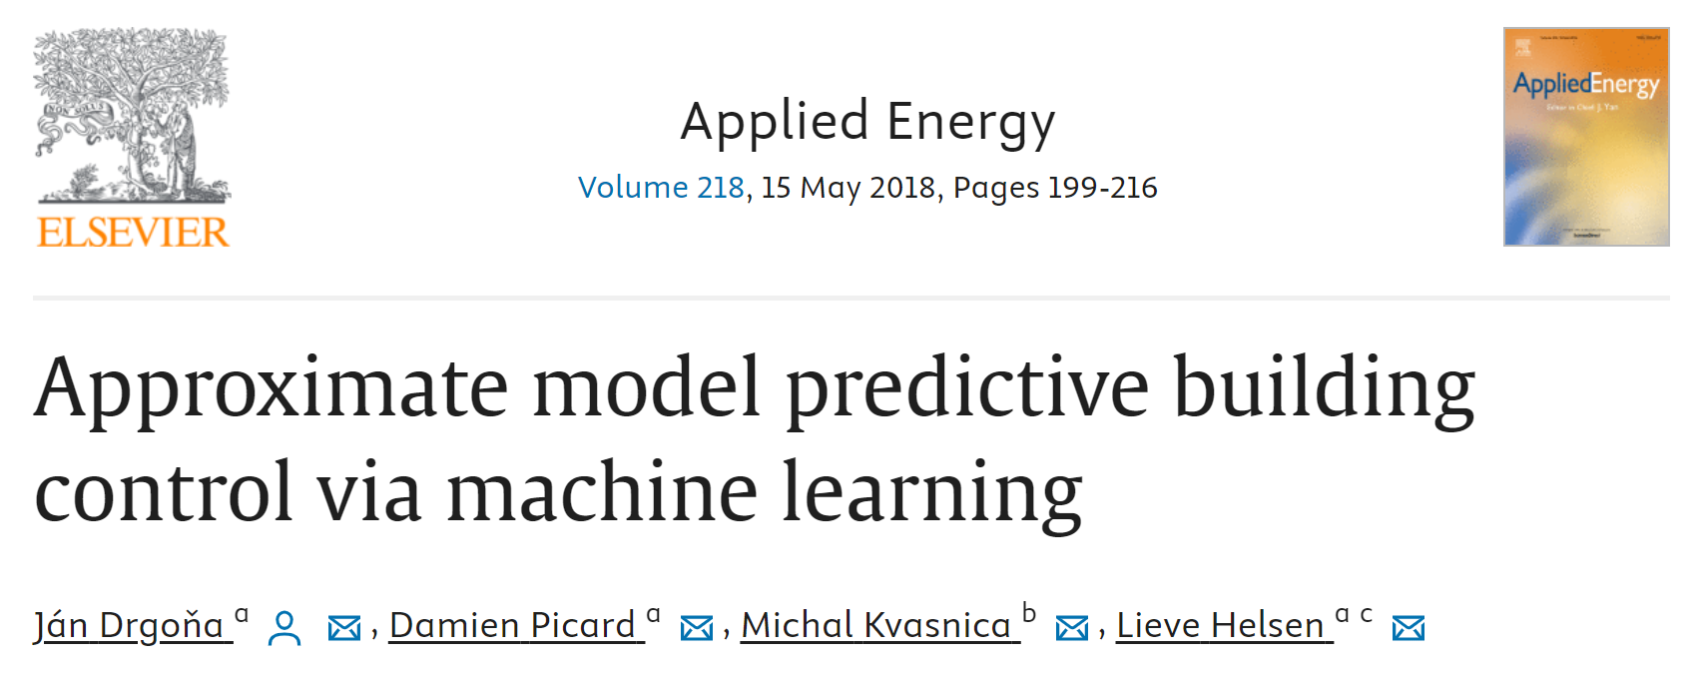



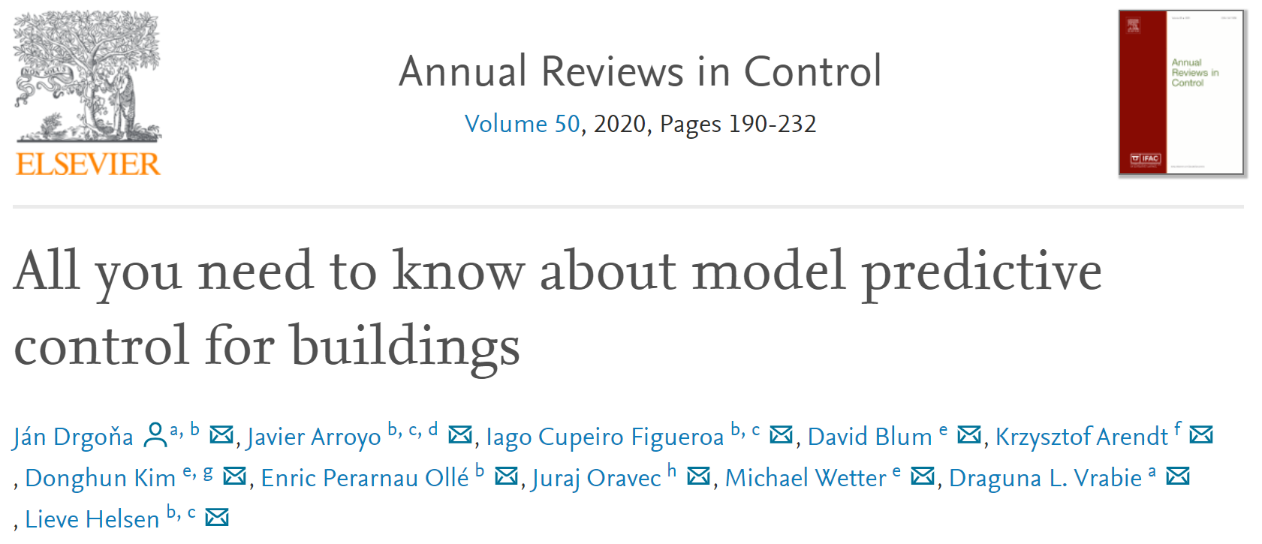


Our PNNL Team
My Career Path before PNNL
Aaron Tuor
James Koch
Madelyn Shapiro
Wenceslao Shaw Cortez
Brian Hutchinson
Draguna Vrabie

Slide 3
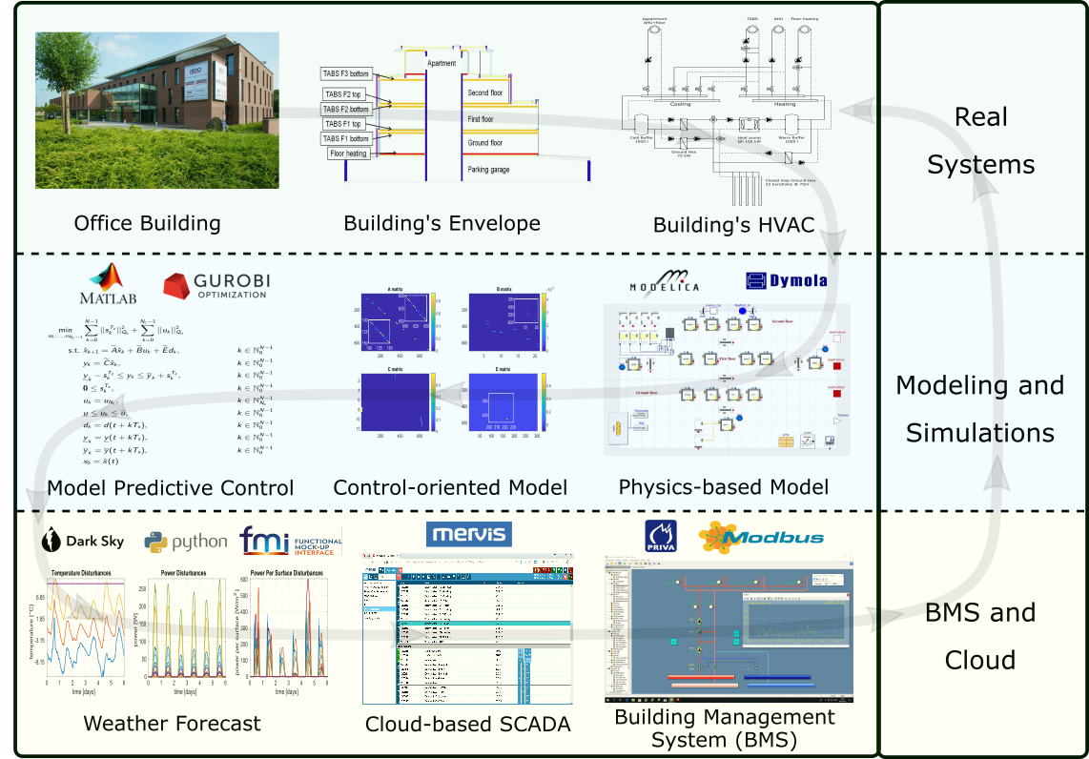

MPC Implementation in Real-world Buildings
Drgona J., et al., Cloud-based implementation of white-box model predictive control for a GEOTABS office building: a field test demonstration. Journal of Process Control, 2019.
Notes:
To better understand the complexity of the task, lets walk through a complete workflow as implemented for a practical use case to control an office building in Belgium.
This office building is equipped with thermally activated building structures with a geothermal heat pump (GEOTABS). These kinds of buildings are known to be very challenging to control due to the large thermal mass and associated time delays. For optimal operation of this type of systems, predictive control is an absolute must.
First one develops a high-fidelity physics-based model based on the available engineering documentation and measurement data.
Then the control-relevant equations are extracted and used to construct an optimization-based predictive controller.
The optimized controls are computed every 15min based on new weather forecast and new measurement from the building, then the controls are communicated to the building management system for execution.
The whole procedure takes approximately a minute to execute in real time.
After using the MPC in the office building for a couple of months the team measured more than 50% energy savings on the heat pump and improved thermal comfort by approximately 37%. The rigid and delayed behavior of the rule-based controller is replaced by dynamic and anticipatory behavior of MPC, which keeps the zone temperatures closer within comfort bounds and delivers cooling only when it is needed.

Slide 4

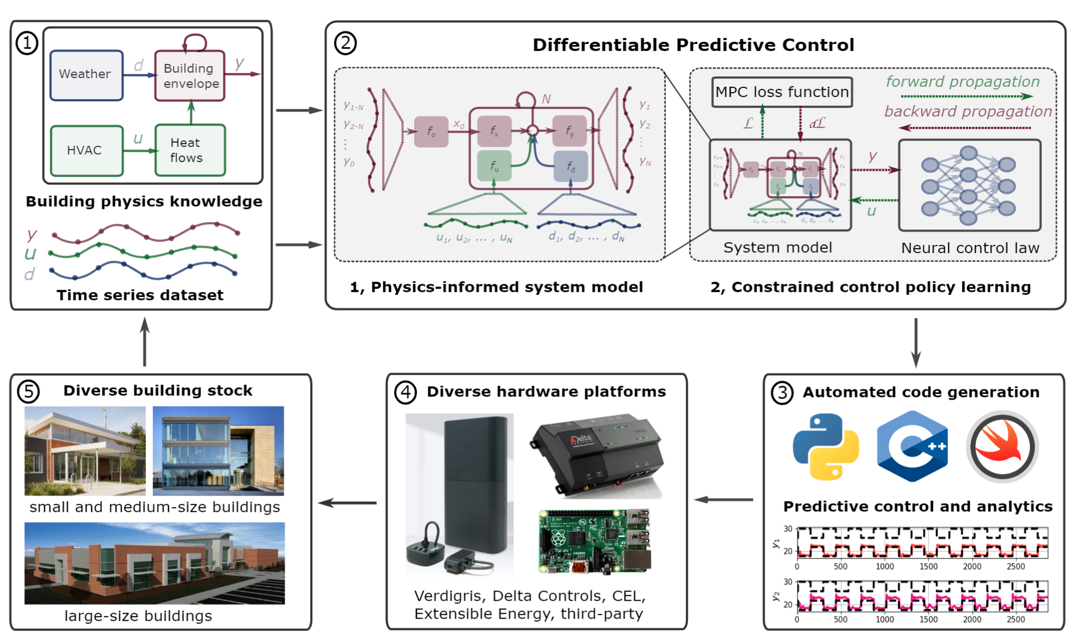

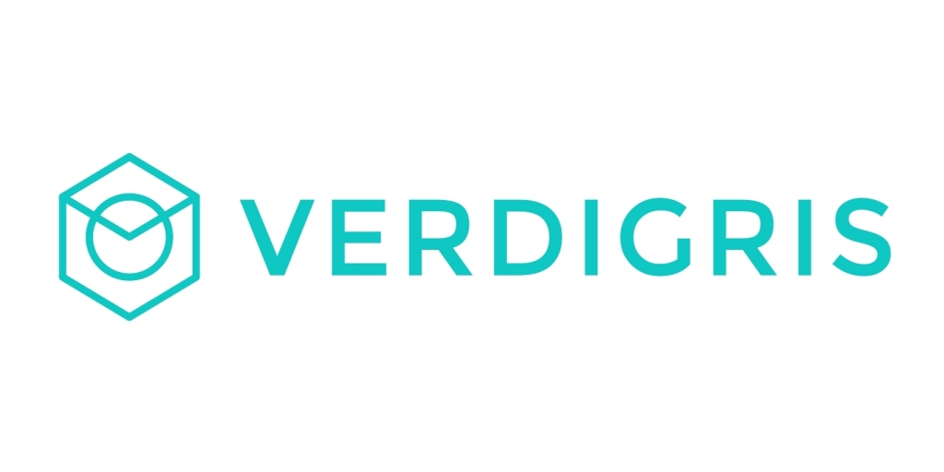


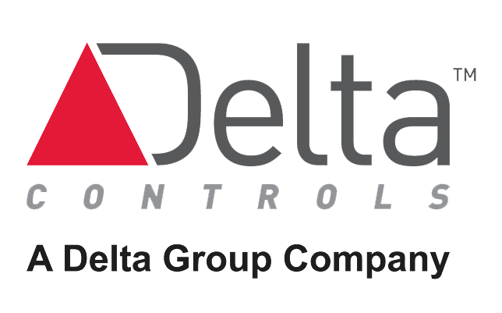

Data-driven Differentiable Predictive Control for Cost-Efficient Building Modeling and Control

Slide 5
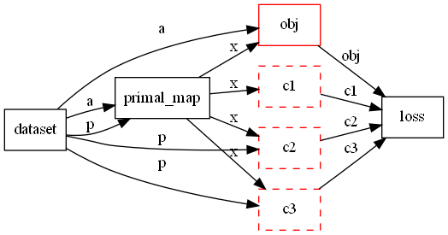
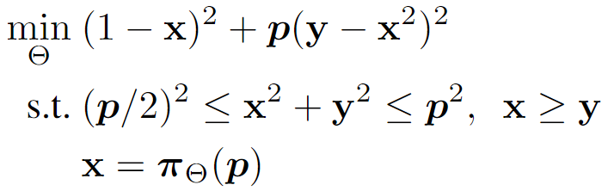

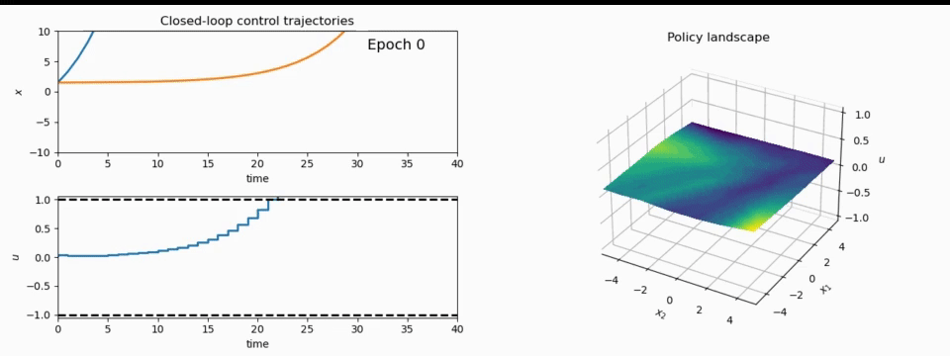
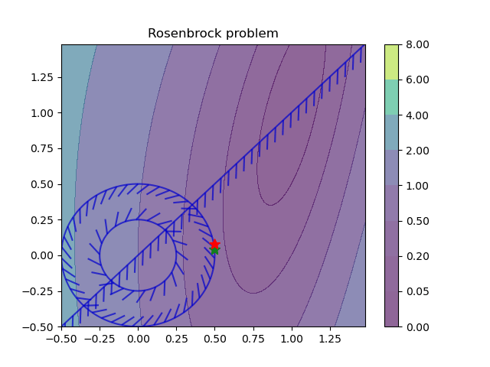
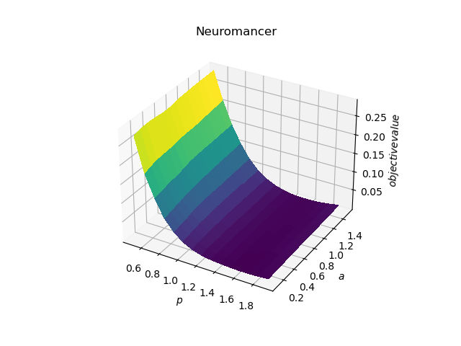
NeuroMANCER: a Scientific Machine Learning Library
1. Mathematical formulation
3. Problem graph
map
2. Python code interface
4. Results
import neuromancer as nm
p = nm.variable(‘p’)
x = nm.variable(‘x’)
y = nm.variable('y’)
obj = ((1-x)**2 + p*(y-x**2)**2).minimize(weight=1.0, name='obj’) c1 = (p/2)**2 <= x**2 + y**2
c2 = x**2 + y**2 <= p**2
c3 = x >= y net = nm.MLP(insize=2, outsize=2, hsizes=[80]*4) map = nm.Node(net, input_keys=['p’], output_keys=[‘x’,‘y’])
loss = nm.PenaltyLoss([obj], [c1, c2, c3]) problem = nm.Problem([map], loss)
optimizer = torch.optim.AdamW(problem.parameters()) trainer = nm.Trainer(problem,data,optimizer)
best_model = trainer.train()

Slide 6

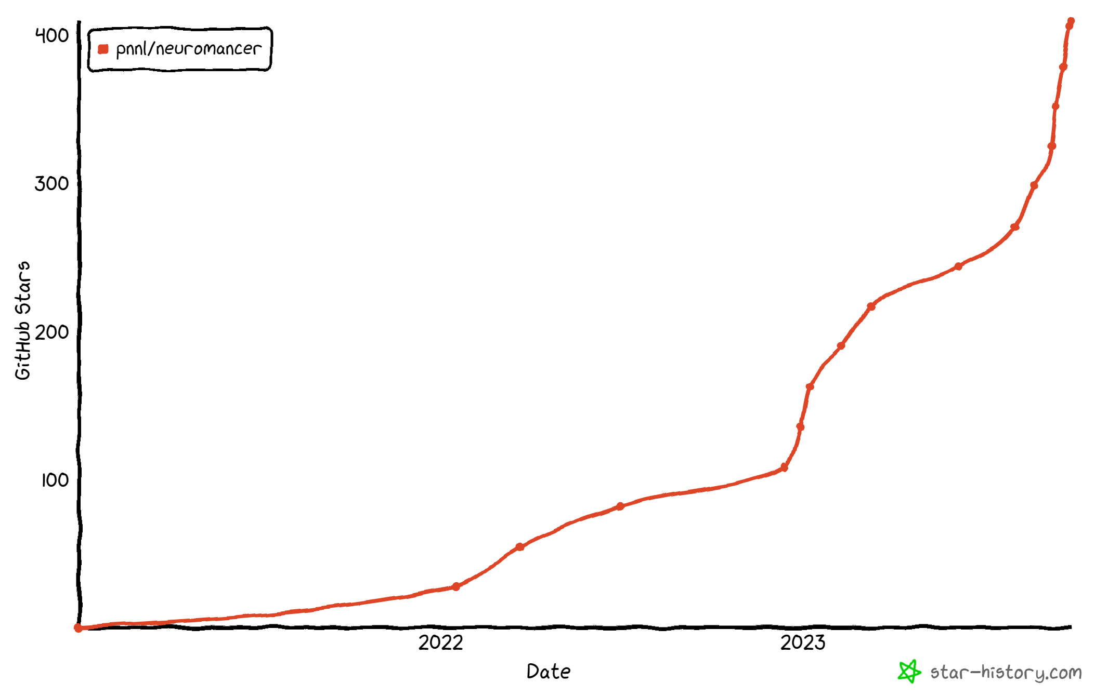
NeuroMANCER
Physics-informed machine learning
Data-driven modeling of dynamical systems
Model-based policy optimization
Parametric constrained optimization
github.com/pnnl/neuromancer

